Slide 1

INSTITUTION OF ENGINEERING Advanced COLLEGE OF ENGINEERING AND MANAGEMNET Department of electronics and computer engineering KUPANDOLE, Lalitpur
Project report on
Mini games
PREPARED BY :
AARYAB PANTA (ACE077BEI001)
ABINAWAN BHATTARAI (ACE077BEI005)
BINISHA MAHARJAN (ACE077BEI010)
NIKESH BARAL (ACE077BEI023)

Slide 2
TABLE OF CONTENTs
INTRODUCTION
PROGRAM ARCHITECTURE
SCOPE AND APPLICATION
ALGORITHM
FLOWCHART
FEATURES
OUTPUT
TIME SUMMARY
CONCLUSION

Slide 3
Introduction
Mini games is a mini project which contain different gameplay element. It is a software application developed using C programming language. This project include three different games and they are:
Guess the number
Guess the number is an interesting mini game in which there will be secret number in the computer. If your guess is too high or too low, you'll get a hint .There will be 5 lives. You will get the score according to your lives. The game will end after 5 attempts and if the player failed to guess the number, and then he/she loses the game.

Slide 4
Introduction
Rock Paper and Scissor
Rock-paper-scissors is a hand game that is played by two people. The players count to three in unison and simultaneously "throw” one of three hand signals that correspond to rock, paper or scissors. The winner is determined by the rules:
Rock smashes scissors
Scissors cuts paper
Paper covers rock
However in our program the concept of this game has been slightly changed. The game is played between player and computer. Computer will randomly choose rock, paper or scissors. And user should also pick any one. The first one to get 3 poin-t will win the game.

Slide 5
Introduction
Hangman
Hangman is a popular word game in which computer (the "chooser") chooses a secret word and player (the "guesser") attempts to guess the word one letter at a time. If a guessed letter appears in the word, all instances of it are revealed and also gain one chance. If not, the guesser loses a chance. If the guesser figures out the secret word before he or she runs out of chances, he or she wins. If not, computer will win. Traditionally, chances are tracked using a stick figure drawing of a person being hanged from a gallows. The figure is drawn one body part at a time, and the guesser loses when the entire figure has been drawn.
Game End The game can end in one of two ways:
If the player has guessed the complete secret word, he or she wins.
Otherwise, if the player has run out of chances and the complete Hangman has been drawn, the player loses.

Slide 6
Program Architecture
The architecture of this program is divided into following category:
Main-menu System:
Main menu system using C programming language is the main junction of program from where the user can access to different game. User can use either up or down arrow to move down or up and press enter to run that game
File Handling System:
The file handling system is used in the program to store the player name and their score. The player name and their score is stored in the local storage in .txt file.
Tools and Environment:
Operating System: Windows10,Ubuntu,Mac
Software used: IDE(Visual Studio code)
Open-source libraries: stdio.h, unistd.h, stdlib.h, time.h, string.h, conio.h

Slide 7
Scope and application
It is good mini project for college presentation
No financial cost, so it can be open source software
Player can use this software in their free time to pass their time
Can be a good source to increase the thinking capacity of user

Slide 8
algorithm
Algorithm of main function
Step01: Start
Step02: Make four function guess_the_number, rock_paper_scissor,hangman and
exit_the_application
Step03: Input user choice
Step04: If
user choice is 1 go to guess_the_number
user choice is 2 go to rock_paper_scissor
user choice is 3 go to hangman
user choice is 4 go to Step 5
Step05: Stop

Slide 9
Algorithm
Algorithm of guess_the_number
Step01: Make 3 function rule_for_gtn , game_of_gtn, display_score
Step02: Input user choice
Step03: If
user choice is 1 go to rule_for_gtn
user choice is 2 go to game_of_gtn
user choice is 3 go to display_score
User choice is 4 go to main function
Algorithm of rule_for_gtn
Step01: Add the rules of game
Step02: Go to guess_the_number

Slide 10
Algorithm of game_of_gtn
Step01: Declare variables number, user_number, lives=5 , score,character
Step03: Generate random number from 1 to 100 using time.h header file assign it to number
Step04: Do until lives != 0 else go to step05 of game_of_gtn
input user_number
if user_number == number
display you won
assign score according to number of lives
go to save_score function by passing the value of score
input character
if character is ‘y’ go to game_of_gtn
else if character is ‘h’ go to guess_the_number
if user_number !=number
decrease live and give hint
go to step 04 of game_of_gtn
Step05: Display you loose and input character
if character is ‘y’ go to game_of_gtn and if ‘h’ go to guess_the_number

Slide 11
Algorithm
Algorithm of save score
Step01: Initialize the score that was passed through game_of_gtn function and name
Step02: Input name
Step03: Append “score.txt” file and store the name and score there
Step04: Close the file
Step05: Return back
Algorithm of display score
Step01: Search “score.txt” file and display all the content inside that file
Step02: Go to guess_the_number

Slide 12
Algorithm
Algorithm of rock_paper_scissor
Step01: Make 3 function rule_for_rps , game_of_rps, display_score_of_rps
Step02: Input user choice
Step03: If
user choice is 1 go to rule_for_rps
user choice is 2 go to game_of_gtn
User choice is 3 go to main function
Algorithm of rule_for_rps
Step01: Add the rules of game
Step02: Go to rock_paper_scissor

Slide 13
Algorithm of game_of_rps
Step01: Declare variables number, you, computer, poc, pou, character
Step02: Make game2_of_rps
Step03: Do until poc==3 OR pou==3 else go to step 4
Generate random number from 1 to 100 using time.h header file assign it to number
If
num<=33 , computer= ‘r’
num>33 AND num<=66 , computer= ‘p’
num>66 , computer = ‘s’
Input you (you should be ‘r’ or ‘p’ or ‘s’)
Pass you and computer in game2_of_rps function
If
game2_of_rps==1, pou ++
game2_of_rps==-1,poc++
game2_of_rps==0,pou=pou+0
Go to step 3
Step04: If poc==3 display computer won else display user won and save the score in .dat file
Step05: If character ==‘y’ go to game_of_rps else if character==‘h’ go to rock_paper_scissor

Slide 14
Algorithm
Algorithm of game2_of_rps
Step01: Initialize the two variable you and computer that was passed from game_of_rps
Step02: if (you == comp)
return 0;
if (you == 'r' && comp == 'p')
return -1;
else if (you == 'p' && comp == 'r')
return 1;
if (you == 'p' && comp == 's'){
return -1;
else if (you == 's' && comp == 'p')
return 1;
if (you == 's' && comp == 'r'){
return -1;
else if (you == 'r' && comp == 's'){
return 1;
Algorithm of display_score
Step01: Import score from score_of_rps .dat
Step02: Display score
Step03: Return to rock_scissors_paper

Slide 15
algorithm
Algorithm of hangman
Step01: Declare variables word, answer, letters,letter,life=5
Step02: Ask user if they know how to play hangman. If ‘yes’ go to step 3 of hangman else print rule and then go to step 3 of hangman
Step03: Create different random word and also their length and place it in switch case
Step04: Pick up any random word and assign it to word and length of word to letters
Step05: Display “_” for value of letters time
Step06: Ask user to pick any word and assign it to letter
Step07: Use strchar() function to know if letter is in word or not. If true say correct guess and also display that word in correct position. Else say wrong guess
and deduct the life by 1
Step08: If user could guess the word go to step 11of hangman or go to step 5 of hangman till life!=0
Step09: Display you loose and also display the word
Step10: Ask user if they want to play if yes go to Step04 of hangman else go to main function
Step11: Display you won
Step12: Go to step 10

Slide 16
Flowchart
Start
a
Guess the number
Rock, Paper and Scissor
Hangman
Exit application
b
c
d
Stop

Slide 17
flowchart
b
Rules
Game
Display Score
Exit
Display rules
Run game
Search File
a
Importing
Display the score
b
Save score
Ask user to play again?
Exporting
T
Score.dat
b
F

Slide 18
flowchart
c
d
Welcome
Rules
Game
Display Score
Exit
Ask rule?
T
Display rules
Display rules
Run game
Search file
a
F
c
Save score
Run game
Display the score
T
T
Ask user to play again?
IMPORTING
Ask user to play again?
EXPORTING
F
F
Score.dat
c

Slide 19

Features
Mini game is a software application developed using C programming language
It doesn’t occupy large space and can also be run in low end pc
It is a user interactive application
It also has a file handling feature to store the data in .txt file

Slide 20
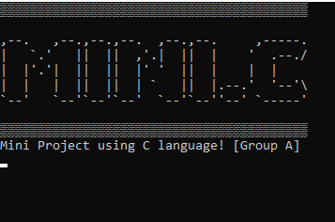
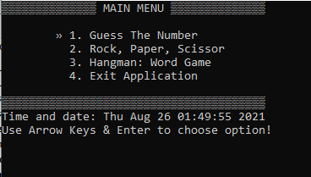
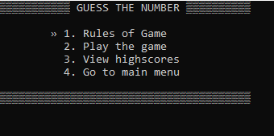
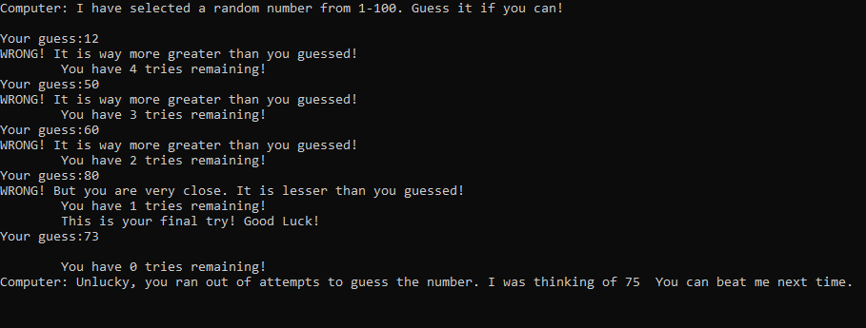
Output

Slide 21
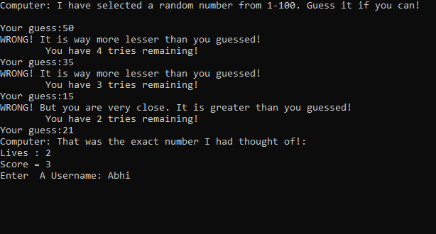
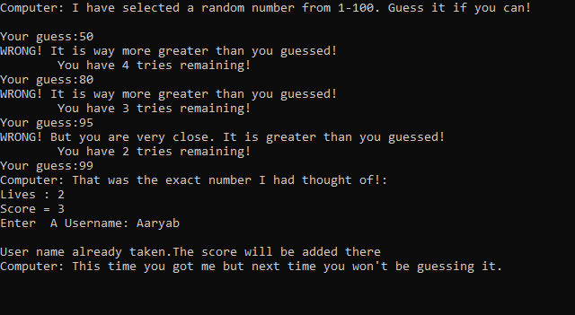
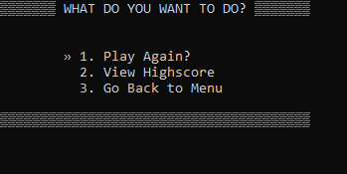
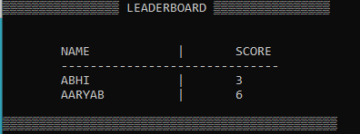
Output

Slide 22
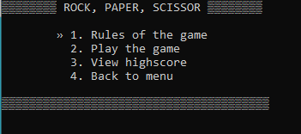
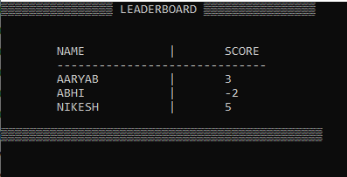

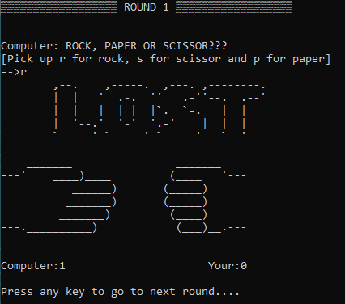
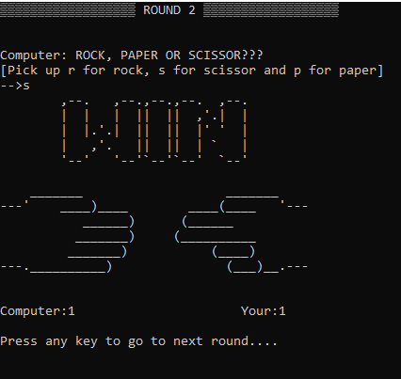
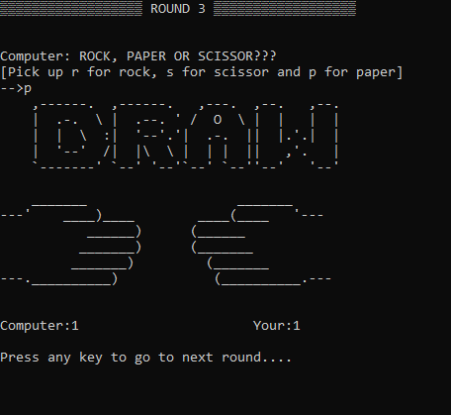
Output

Slide 23
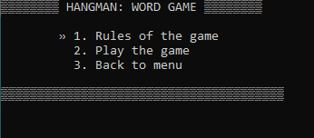
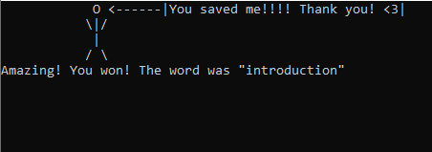
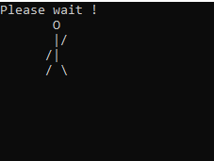
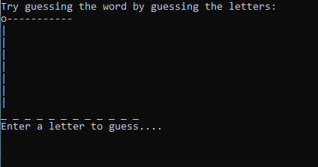
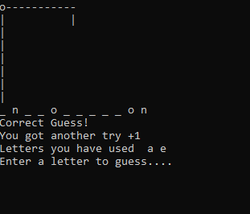
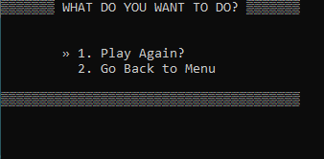
Output

Slide 24
Time summary
7
2

Slide 25
Conclusion
It was a wonderful and learning experience for us while working on this project. This project took us through the various phases of project development and gave us the real insight into the world of C programming. The joy of work and thrill involved while tackling the various problem and challenge gave us a fell of program developer. It was a wonderful and learning experience for us while working on this project.

